Slide 1
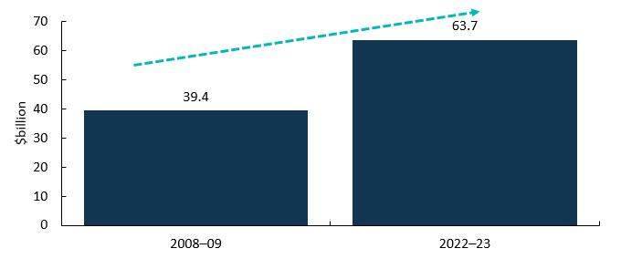
Cultural and Creative Activity in Australia, 2008–09 to 2022–23 (Methodology Refresh)
Cultural and creative activity refers to the economic activity generated from the production and support of goods and services created by cultural and artistic means.
New estimates have been developed to measure cultural and creative activity in Australia. These estimates reflect major revisions to the methodology and to the scope of activity considered to be cultural and creative.
The new estimates cover the period from 2008–‍09 to 2022–‍23, which includes COVID-19’s impact on cultural and creative activity from March 2020 to June 2023.
All data tables presented in the statistical report are also available in excel. Further information on these updates can be found in the FAQ: Cultural and Creative Activity in Australia, 2008–09 to 2022–23.
New estimates show that cultural and creative activity was $63.7 billion in 2022–‍23, up from $39.4 billion in 2008–‍09.
Chart 1: Cultural and creative activity, 2008–09 and 2022–23
Source: ABS Australian System of National Accounts, Australian National Accounts: Input-Output Tables (Product Details); Australian National Accounts: Supply Use Tables; BCARR calculations.

Slide 2
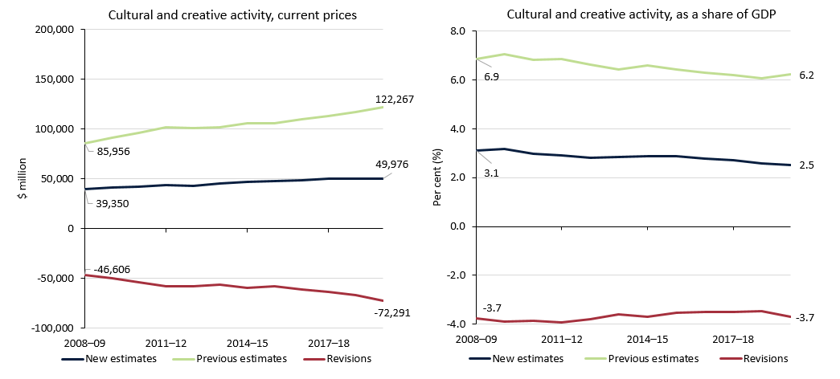
Revisions to previous reporting estimates, 2008–09 to 2019–20
The new estimates show cultural and creative activity grew at a slower rate than the previous estimates in current price terms (nominal values).
However, as a share of Gross Domestic Product (GDP), the gap between the new and previous estimates has remained largely unchanged (as a percentage point difference between 2008–09 and 2019–20).
The new scope’s exclusion of computer system design and related services, and clothing and footwear manufacturing, wholesaling and retailing industries is the main reason why the new estimates are much lower than the figures reported previously.
Chart 2: Results of revisions from the previous estimates, 2008–09 to 2019–20
Source: ABS Australian System of National Accounts, Australian National Accounts: Input-Output Tables (Product Details); Australian National Accounts: Supply Use Tables; BCARR calculations.

Slide 3
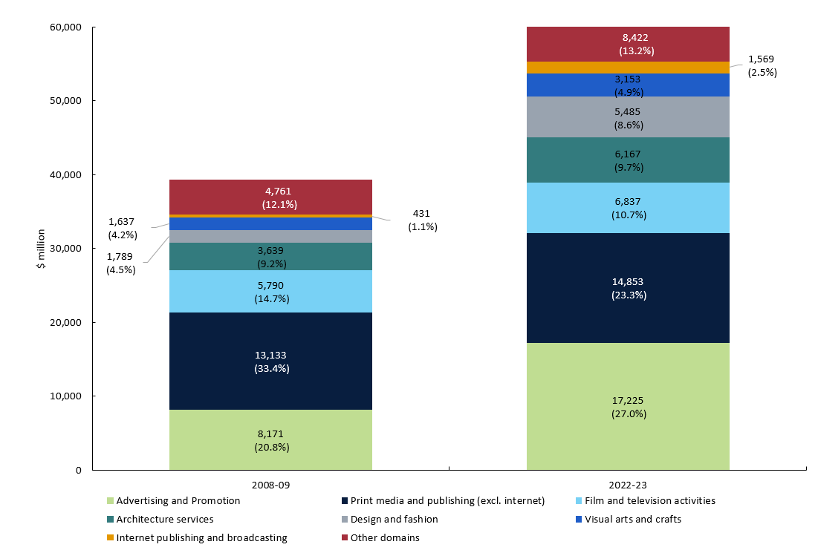
Cultural and creative activity, GDP by domain
Chart 3: Contribution to cultural and creative activity, GDP by domain, 2008–09 and 2022–23
Most cultural and creative domains grew in nominal terms over the period from 2008–09 to 2022–23.
Advertising and promotion activity grew strongly over the period (↑$9.1 billion).
This growth was mainly driven by advertising services, with an increase of $6.9 billion over the period.
Print media and publishing activity (excl. internet) grew (↑$1.7 billion) over the period but now makes up a smaller share of GDP. The increase was mainly driven by software publishing activities that have experienced strong growth in recent years, but was offset by the decrease in newspaper, magazine and other periodic publishing activities.
Film and television activity (↑$1.0 billion) and architecture services (↑$2.5 billion) both increased in nominal terms from 2008–09 to 2022‑23.
Source: ABS Australian System of National Accounts, Australian National Accounts: Input-Output Tables (Product Details); Australian National Accounts: Supply Use Tables; BCARR calculations.

Slide 4
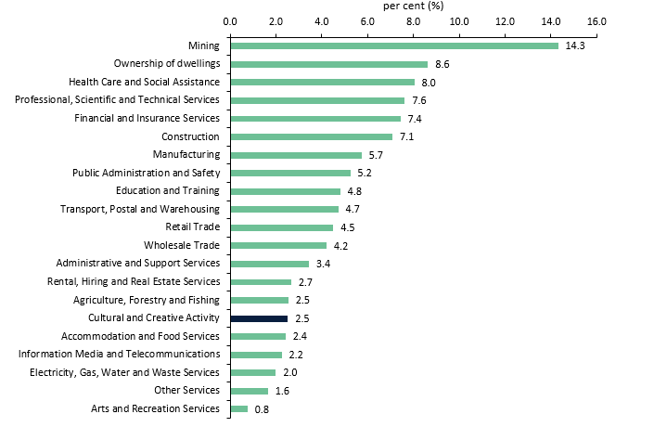
Comparison with Australian industries
Cultural and creative activity also accounted for 2.5% of gross value added (GVA) ¹ in the economy in 2022–23.
This is comparable to the size of the Agriculture, Forestry and Fishing industry, also at 2.5%, or the Accommodation and Food Services industry, at 2.4%.
Note: Cultural and creative activity is not an industry division, but rather includes output produced by many industries across the economy, including output from the Arts and Recreation Services division as well as from other industries profiled in this chart.
Chart 4: Cultural and creative activity GVA and industry share of total economy, 2022–23
¹ GVA is a measure of the contribution to domestic
production made by an individual producer, industry or sector. This is the value of output less the value of the goods and services used up in the process of production. By excluding net taxes, GVA provides a more accurate measure of economic activity by industry than does gross domestic product (GDP).
Source: ABS Australian System of National Accounts, Australian National Accounts: Input-Output Tables (Product Details); Australian National Accounts: Supply Use Tables; BCARR calculations.

Slide 5
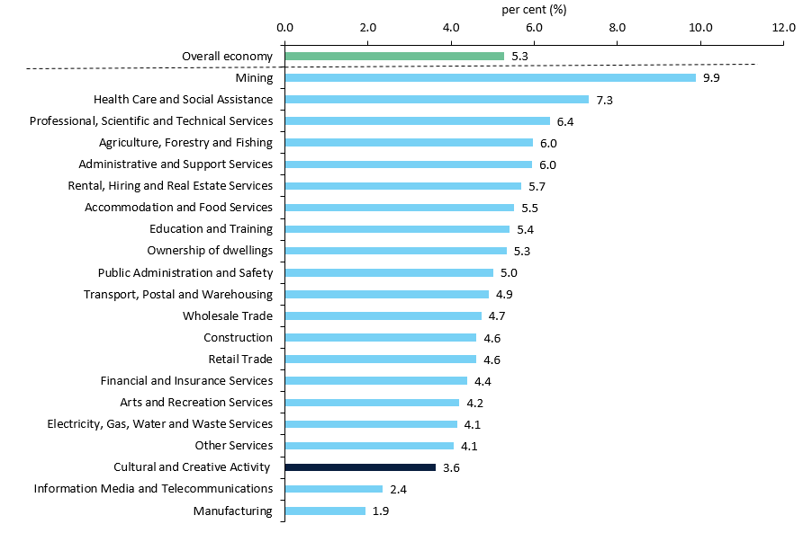
GVA average annual growth rate by industry division, 2008–09 to 2022–23
Chart 5: GVA average annual growth rate by industry division, 2008–09 to 2022–23
The Australian economy has been mainly supported by activities such as mining and healthcare over the period from 2008–09 to 2022–‍23.
During this time, the average annual growth rate in gross value added (GVA) for mining was 9.9% and for healthcare was 7.3%.
The average annual growth rate for the overall economy was 5.3%, while GVA for cultural and creative activity increased by an average of 3.6% during the period.
Source: ABS Australian System of National Accounts, Australian National Accounts: Input-Output Tables (Product Details); Australian National Accounts: Supply Use Tables; BCARR calculations.

Slide 6
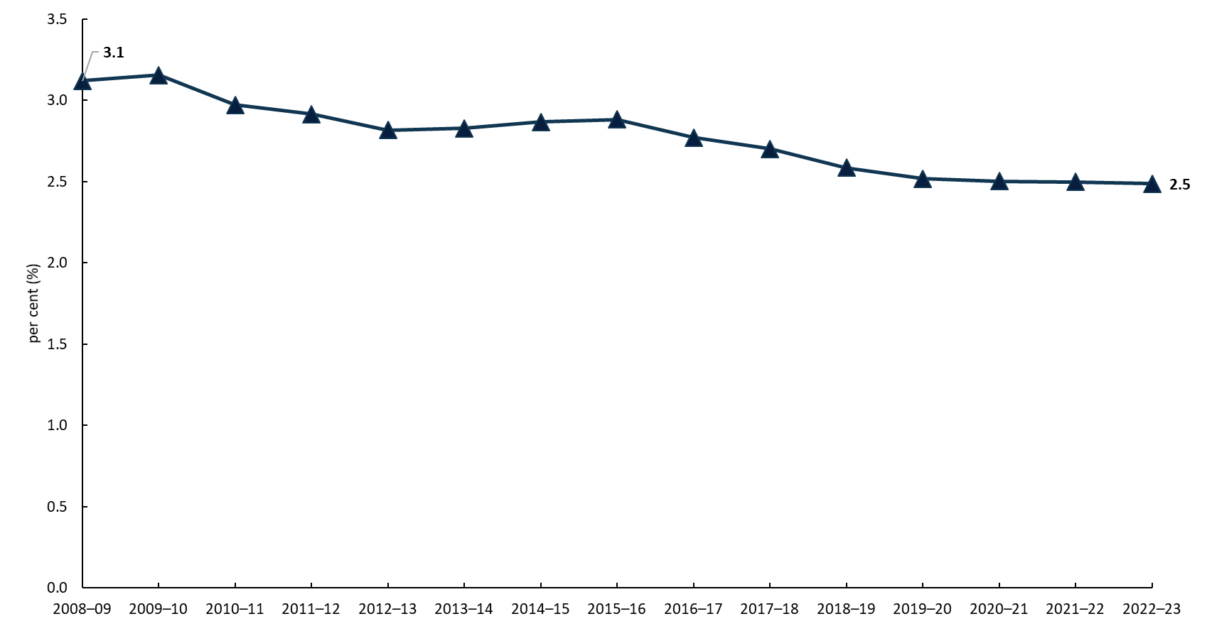
Cultural and creative activity share of GDP
Chart 6: Cultural and creative activity, share of GDP, 2008–09 to 2022–23
Overall, growth in cultural and creative activity has been slower than the pace of growth for the Australian economy.
This largely reflects the continued strength in the mining and healthcare sectors, which fall almost entirely outside of cultural and creative activity.
As a share of GDP, cultural and creative activity declined from 3.1% in 2008–09 to 2.5% in 2022–23.
Source: ABS Australian System of National Accounts, Australian National Accounts: Input-Output Tables (Product Details); Australian National Accounts: Supply Use Tables; BCARR calculations.
About this document The Bureau of Communications, Arts and Regional Research (BCARR) within the Department of Infrastructure, Transport, Regional Development, Communications and the Arts has provided new estimates of the economic contribution of Cultural and Creative Activity in Australia, from 2008–09 to 2022–23. This document outlines the key findings from the tables and figures shown in BCARR’s statistical working paper: Cultural and Creative Activity in Australia, 2008–09 to 2022–23 (Methodology Refresh) and is presented alongside a document of Frequently Asked Questions. Further information on the methods used in this research can be found in BCARR’s consultation paper and the statistical working paper: Cultural and Creative Activity in Australia, 2008–09 to 2022–23 (Methodology Refresh).

